Slide 1

Employee Details of VAT Solution Pvt Ltd

Slide 2
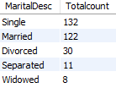

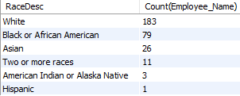
Dashboard
1. Diversity report: Analyse the current workforce in terms of marital status, race, age and gender
(a) : Analyse the current workforce in terms of marital status.
Code :
Result :
Comment : Total 303 employees are working in VAT solution
and 132 Employees are Singles which is greater
than other category
(b) : Analyse the current workforce in terms of race.
Code :
Result :
Comment : 183 Employees pertain to White and only 1 employee
is Hispanic which is the lowest

Slide 3

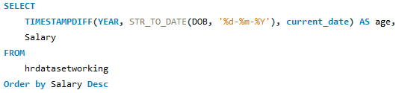


Dashboard
1. Diversity report: Analyse the current workforce in terms of marital status, race, age and gender
(c) : Analyse the current workforce in terms of Age.
Result :
Code :
Comment : Age 69 have the highest salary in the company.
(d) : Analyse the current workforce in terms of gender.
Code :
Result :
Comment : Female Employees are greater than male.

Slide 4


Dashboard
2. Employee satisfaction: Analyse the employee satisfaction profile for each of the
four performance ratings that were given in 2019 (PIP, NI, Meets, Exceeds)
Code :
Result :
Comment : Following are the average rating for all performance Exceed 4, Fully Meets 3.97,
Need Improvement 3.5 and PIP 2.67

Slide 5

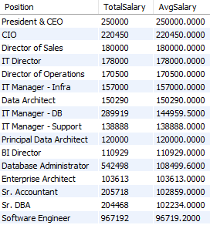
Dashboard
3. Compensation distribution: Analyze the wage bill in terms of how much is spent across
each type of role (Position) within the company, and the
average salary of person in each of the roles.
Code :
Result :
Comment : Total 32 Unique position are present in data and
highest average salary is for Position 'president & CEO'
Note : Unable to show the all position due to space limitation

Slide 6

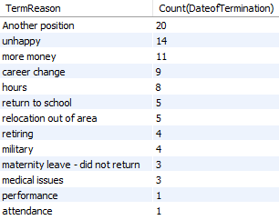
Dashboard
4. Attrition analysis: Analyse how many people have left each year, type of exit, and reasons
given if exit was voluntary.
(a) Attribution by Term Reason
Code :
Result :
Comment : Total 88 Employee have left their job Voluntary and 20
Employee switched for 'Another Position'

Slide 7

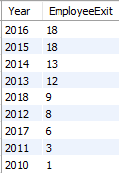
Dashboard
4. Attrition analysis: Analyse how many people have left each year, type of exit, and reasons
given if exit was voluntary.
(b) Attribution by Year
Code :
Result :
Comment : Most Employees (18) left their job in 2015 and 2016
respectively

Slide 8
Dashboard
Thank You

